Slide 1



Slide 2

LIBRARY MANEGMENT PROJECT
Guide by :- M. B. Dahiwal Sir
Dipali Sadashiv Gavande
Information Technology
197015

Slide 3



z
Aim to Create this Project
To make easy to store all the data & make it available
Minimum time as much as can possible.
Make easy to manage library.
It help full to store long time data
Easy to find any data related to books
This Photo by Unknown author is licensed under CC BY-NC-ND.

Slide 4
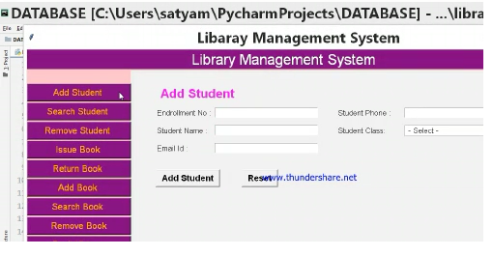
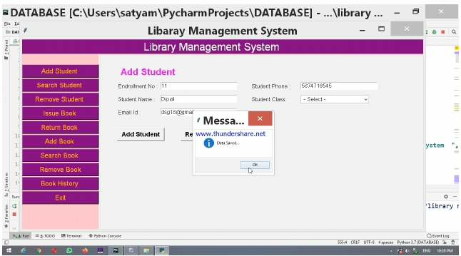
FUNCTION ADD STUDENT
z
In aside image you can see "add student function "
As shown it the image you have to fill some details about student
AND HERE IS RESULT👉

Slide 5
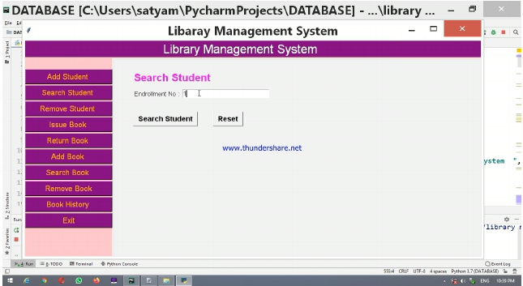
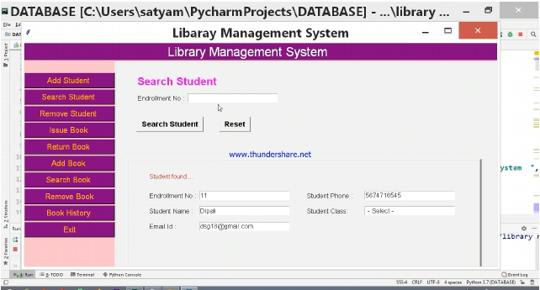
FUNCTION SEARCH STUDENT
Here is a "search student" function where you need to Enterd only Roll number of that specific student because we have used Roll number as a primary key of data base.
Click on Search Student
👈AND HERE IS YOUR RESULT

Slide 6

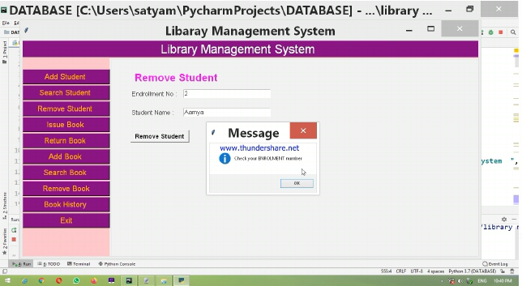
FUNCTION REMOVE STUDENT
In aside image you can see "Remove Function"
Here you have to Enter Roll Number and name of the student
AND HERE IS RESULT👉

Slide 7
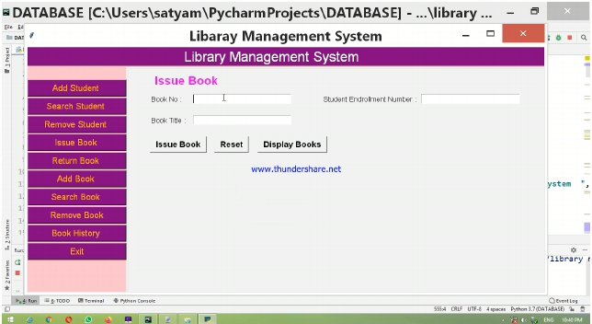
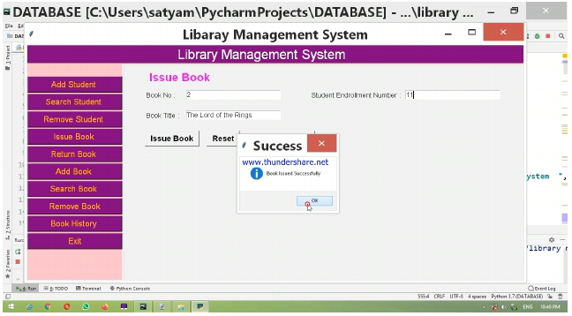
FUNCTION ISSUE BOOK
In aside image you can see the "Issue Book" function
Here we have to enter Book Number, Student Roll Number & Book Number
AND HERE IS RESULT👉

Slide 8
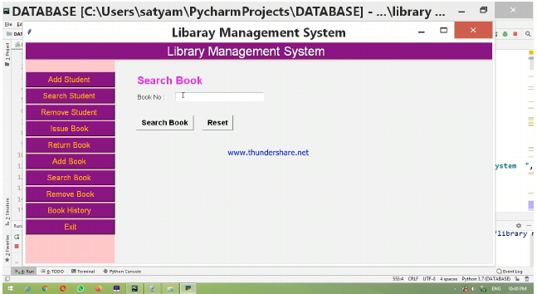
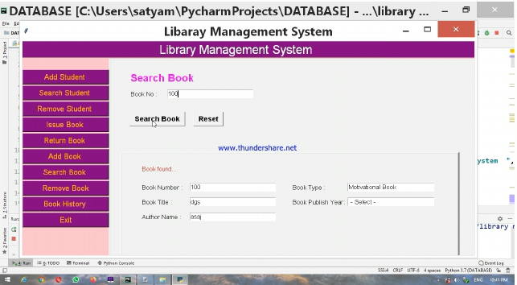
FUNCTION SEARCH BOOK
In aside image you can see "Search Book" Function
Here we only have to Enter Book number because in this function we use book number as primary key
AND HERE IS RESULT👉

Slide 9


FUNCTION REMOVE BOOK
In aside image you can see "Remove Book" Function
Here you have to enter book number and book name/title
👈AND HERE IS YOUR RESULT

Slide 10

FUNCTION EXIT
After pressing "Exit" button "EXIT" function will execute
Then you can see database window
DATA BASE WINDOWS ARE DIPLAY IN NEXT SLIDE 👉

Slide 11
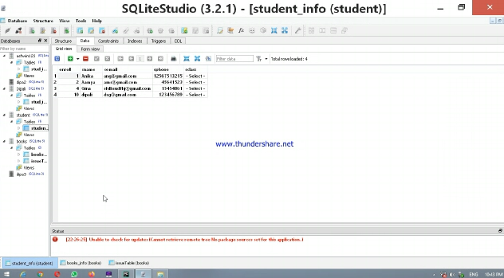
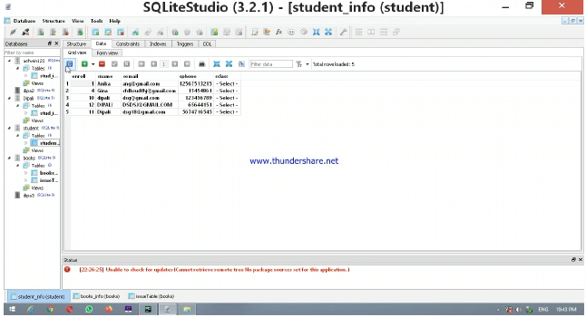
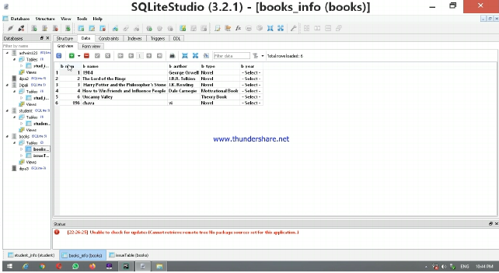
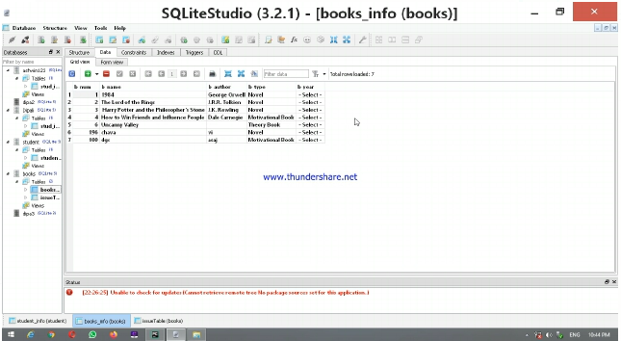
DATA BASE OUTPUTS

Slide 12
THANK YOU 🙏

